Slide 1

STATISTICS

Slide 2


Statistics
Descriptive statistics
Inferential statistics
Descriptive statistics describes statistically a SAMPLE of a group.
It doesn’t try to guess how could be the full group, only the SAMPLE
There is NO UNCERTAINTY
Based on “random SAMPLE” statistics makes inferences about a broader population.
Takes into account the SAMPLING error
Based on a SAMPLE makes assumptions of a broader population
Statistical measures have UNCERTAINTY because of the CHOSEN SAMPLE
00

Slide 3

Statistics
Frequency
Number of times that a given value shows up out of total:
Where “ni” is the number of times that a particular value shows up, and N is the total number of values.

Slide 4
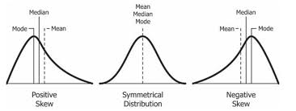
Statistics
Descriptive
Measures of central tendency
Mean = The average
Median = After sorting the values, the lowest value which is:
Bigger than half of the values and low
Lower than half of the values.
Mode = The most frequent value

Slide 5


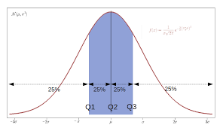
Statistics
Descriptive
Measures of dispersion
Sample Standard deviation (SD):
Population Variance (var):
Range = Maximum value - minimum value
Quartiles = Sort your values from the lowest to the highest. Then determine the values for which you have (25%, 50%, 75%) of the total data
Quantiles/Percentiles = Sort your values from the lowest to the highest. Values for which you have a given % of the total data. Quartiles are a particular case of percentiles.

Slide 6
Statistics
We can use the method: .describe()
CAVEAT! Only with numerical features.
How we can get all this information with Pandas?

Slide 7

Statistics
Outliers
An outlier is a value which is extremely bigger or smaller than the others.
Reasons of finding an outlier:
A typo
An underrepresented sample of of a bigger population.
To identify outliers get a “box-plot”!

Slide 8
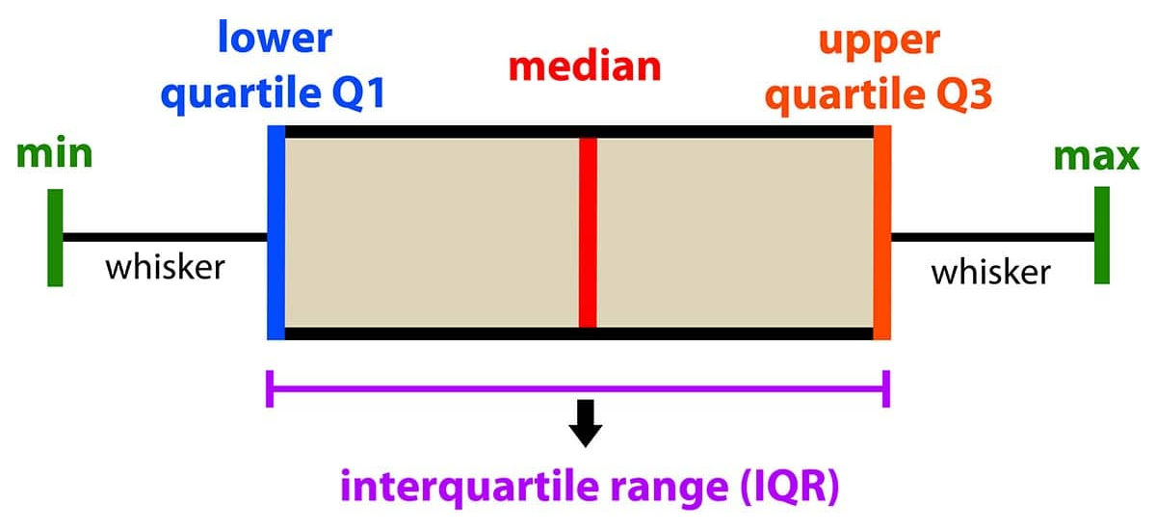
Statistics
A “box-plot” is a graph which displays:
Q1, Q2, Q3, Q1-1.5*IQR, Q3+1.5*IQR
Provides a schematic representation of our distribution
Helps to identify outliers (observations outside the wiskers)
Box-plot

Slide 9

Statistics
We need to take the following steps:
Get the box-plot
Identify the outliers:
Remove them?
Replace their values with the value of the closest whisker
Replace their values with another “reasonable” value
How we deal with outliers?

